Slide 1
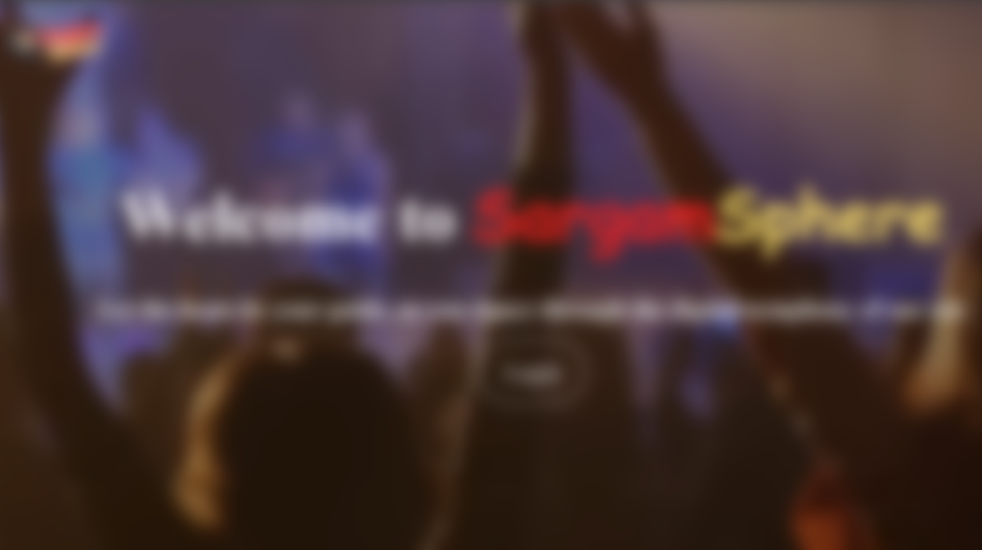
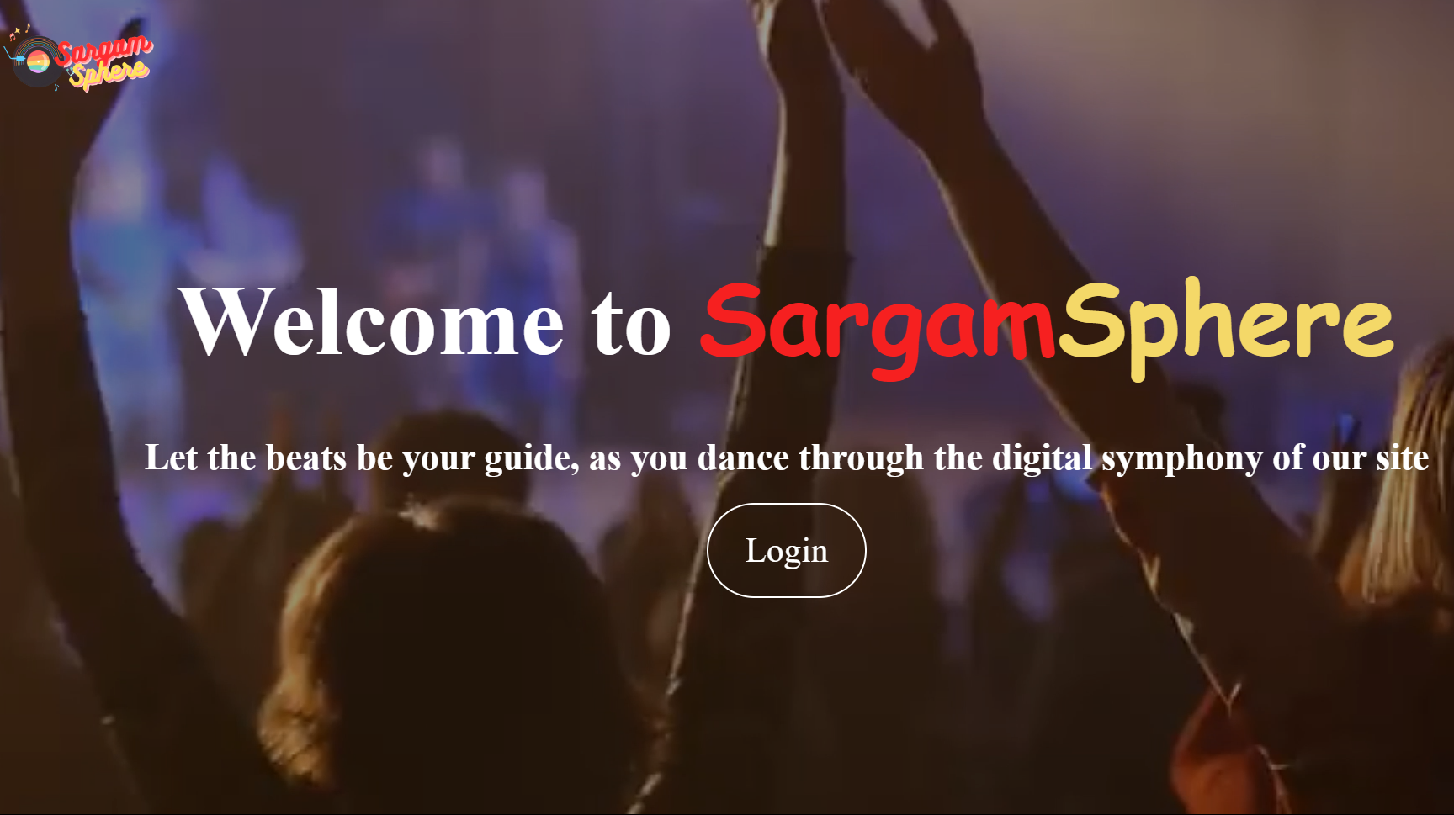
ONLINE MUSIC STREAMING PLATFORM
PYTHON DJANGO

Slide 2
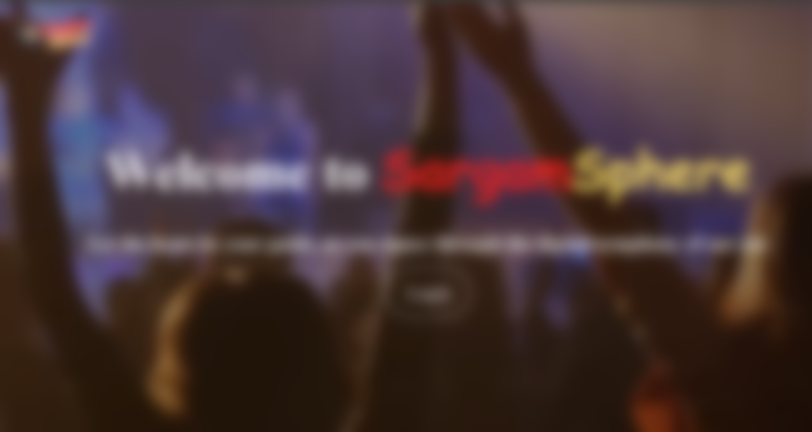





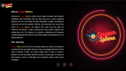
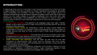
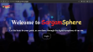
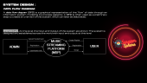
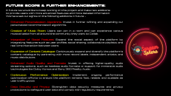
ONLINE MUSIC STREAMING PLATFORM
CONTENTS :
ABOUT US
SYSTEM DESIGN
FUTURE TRENDS
SYSTEM ANALYSIS
SCREENSHOTS

Slide 3

ONLINE MUSIC STREAMING PLATFORM
CONTENTS :
SYSTEM DESIGN
ABOUT US
SYSTEM DESIGN

Slide 4
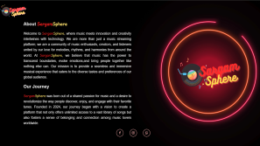
ONLINE MUSIC STREAMING PLATFORM
CONTENTS :
ABOUT US

Slide 5
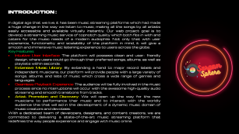

ONLINE MUSIC STREAMING PLATFORM
CONTENTS :
ABOUT US
SYSTEM DESIGN
SYSTEM ANALYSIS

Slide 6

ONLINE MUSIC STREAMING PLATFORM
CONTENTS :
ABOUT US
SYSTEM DESIGN
SCREENSHOTS

Slide 7

ONLINE MUSIC STREAMING PLATFORM
CONTENTS :
ABOUT US
SYSTEM DESIGN
FUTURE TRENDS

Slide 8
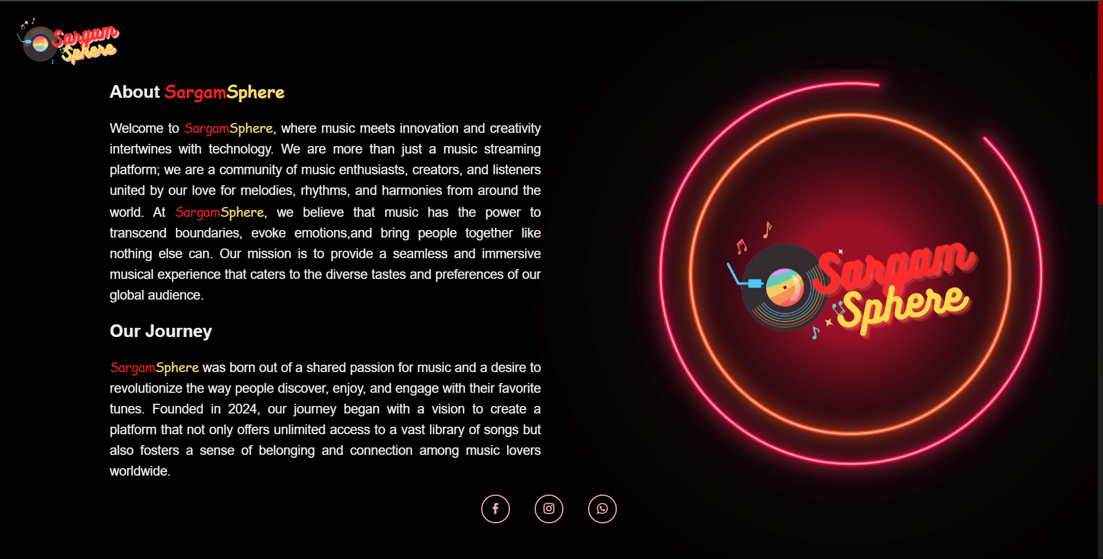

Slide 9
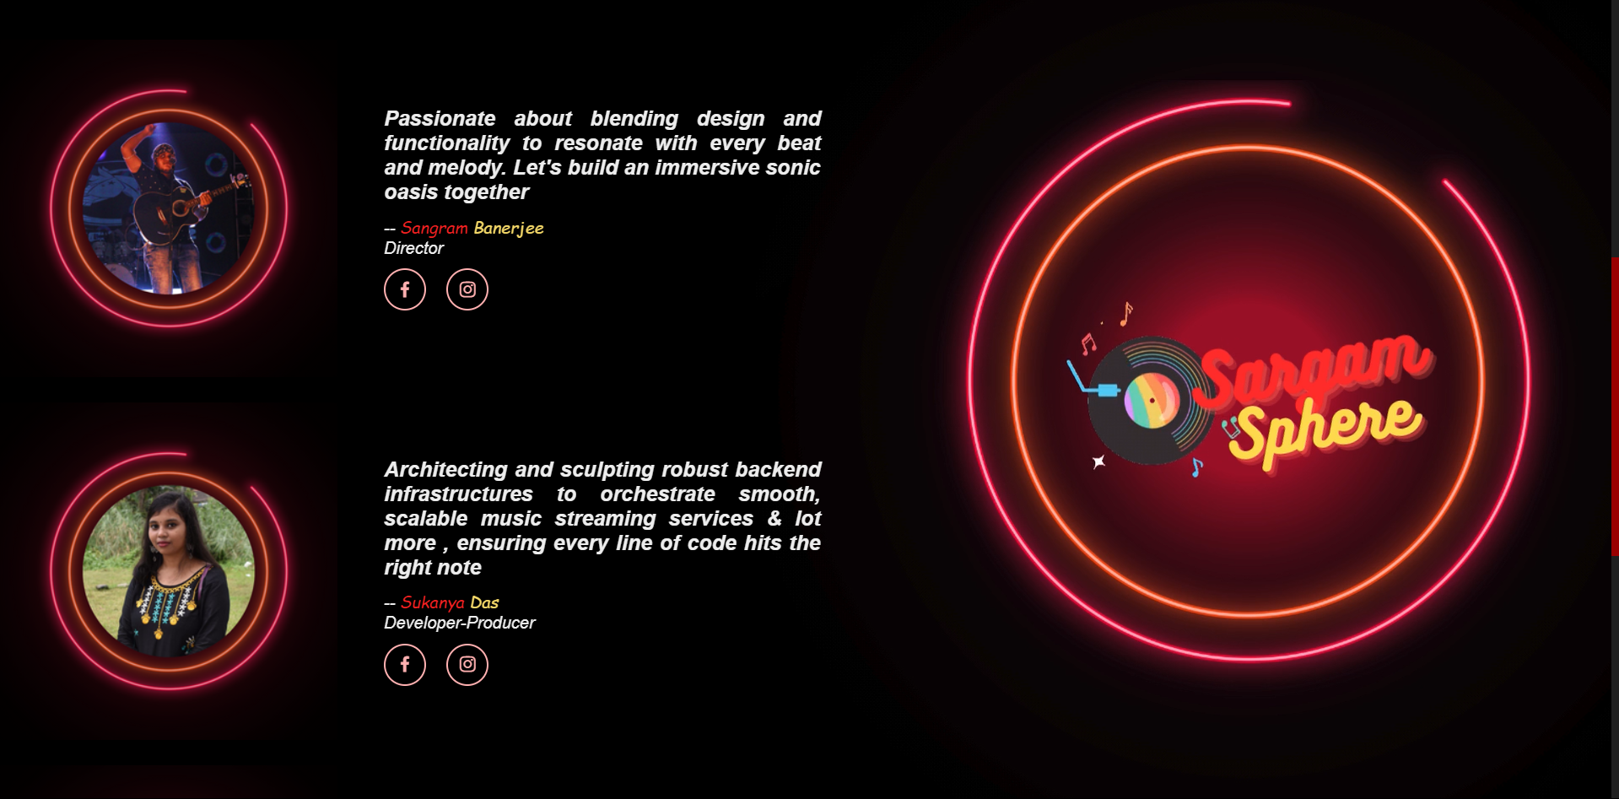

Slide 10
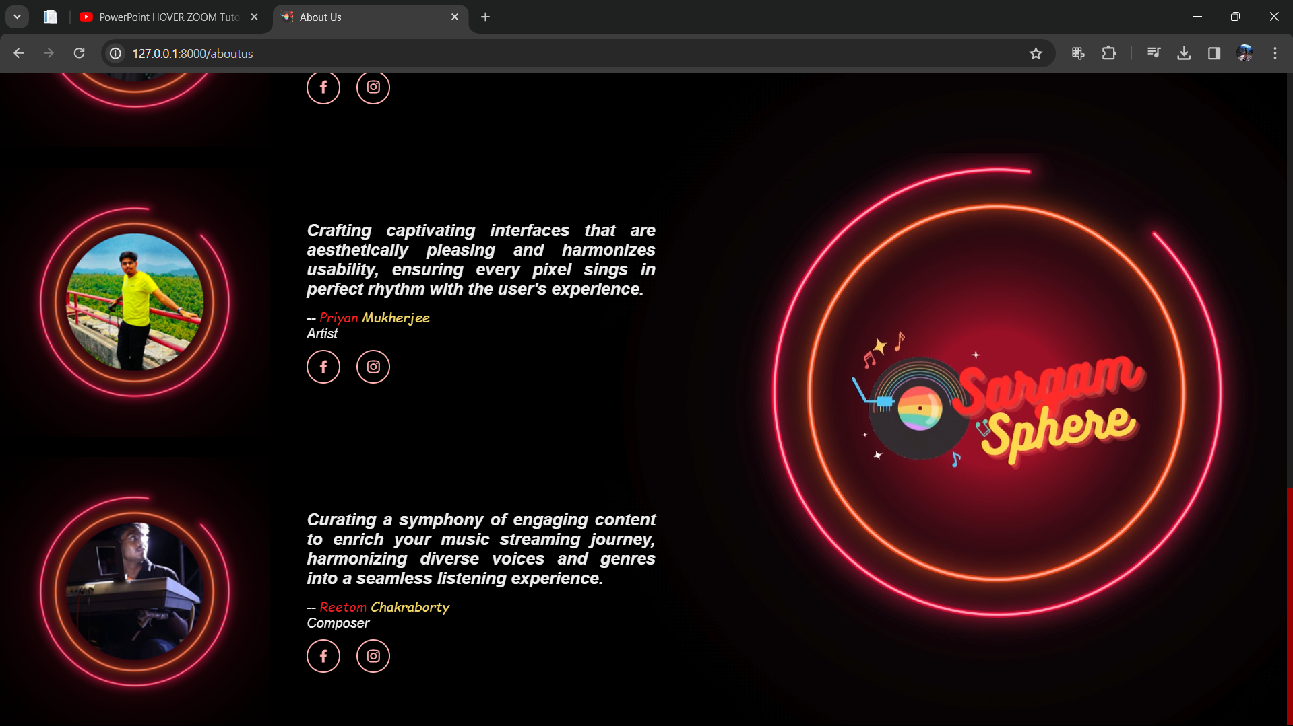

Slide 11

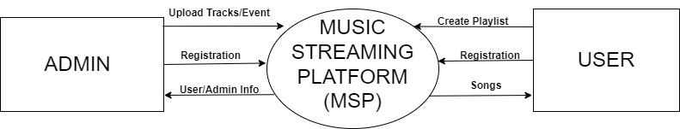
SYSTEM DESIGN :
DATA FLOW DIAGRAM:
A data flow diagram (DFD) is a graphical representation of the "flow" of data through an information system, modelling its process aspects. A DFD is often used as a preliminary step to create an overview of the system, which can later be elaborated.
Level 0 DFD –At this level, the Input and Output of the system are shown. The system is designed and established across the world with input and output at this level.

Slide 12
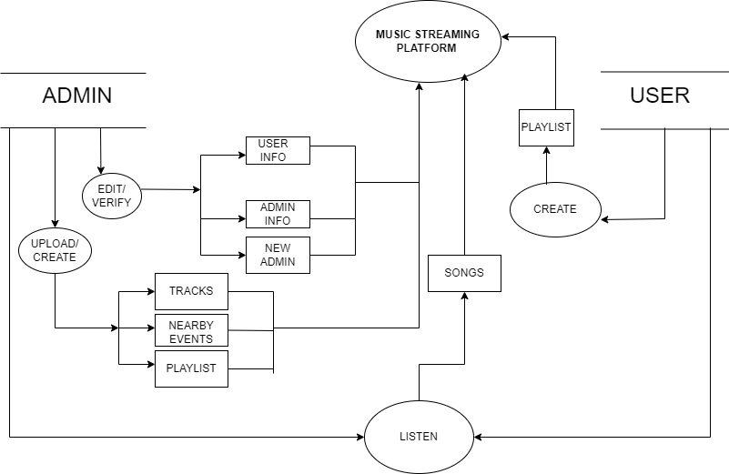
DATA FLOW DIAGRAM:
Level 1 DFD –First Level DFD (1st Level) of Online Music Streaming Platform shows how the system is divided into sub-systems (processes), each of which deals with one or more of the data flows to or from an external agent, and which together provide all of the functionality of the Online Music Streaming Platform as a whole.
It also identifies internal data stores of Playlists, Events, Tracks that must be present in order for the music platform to do its job, and shows the flow of data between the various parts of Online Music Streaming Platform of the system.
DFD Level 1 provides a more detailed breakout of pieces of the 1st level DFD.

Slide 13
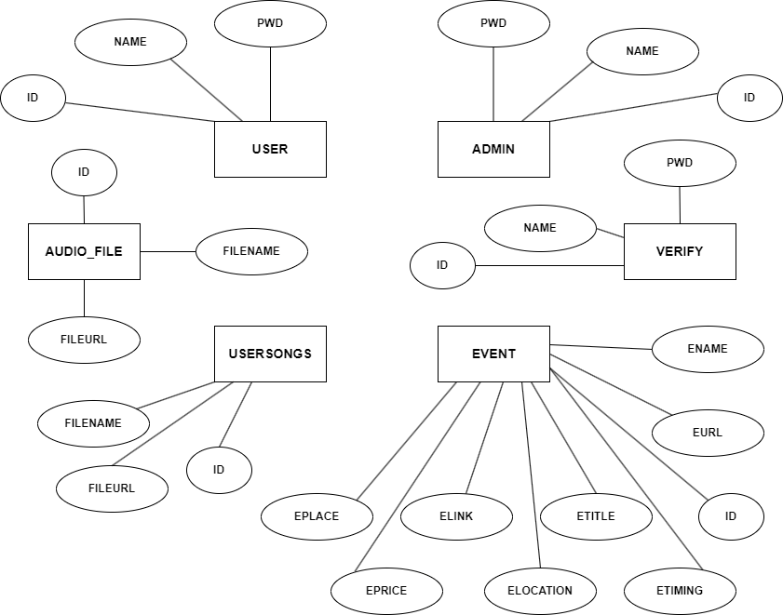
SYSTEM DESIGN :
ENTITY RELATIONSHIP DIAGRAM :
In software engineering, an entity–relationship model(ER model) is a data model for describing the data or information aspects of a business domain or its process requirements, in an abstract way that lends itself to ultimately being implemented in a database such as a relational. The main components of ER models are entities (things) and the relationships that can exist among them.
An entity–relationship model is the result of using a systematic process to describe and define a subject area of business data. It does not define business process; only visualize business data. The data is represented as components (entities) that are linked with each other by relationships that express the dependencies and requirements between them.

Slide 14
INTRODUCTION :
In digital age that we live, it has been music streaming platforms which had made a huge change in the way we listen to music, making all the songs by all artists easily accessible and available virtually instantly. Our web project goal is to develop a streaming music service of topnotch quality which both fits in with and caters for the music needs of a modern audiophile. Not only that with user experience, functionality and scalability of the platform in mind, it will give a smooth and immersive music listening experience to users across the globe.
Key Features:
Intuitive User Interface: The platform will possess clean and user- friendly design, where users could go through their preferred songs, albums, as well as playlists within seconds.
Extensive Music Library: By extending a hand to major record labels and independent musicians, our platform will provide people with a large variety of songs, albums, and lists of music which cross a wide range of genres and languages.
Seamless Playback Experience: The audience will be fully involved in the music process since no interruptions will occur with the awesome high-quality audio streaming and smooth transitions from tracks.
Artist Promotion and Discovery: We will open up the way for the new musicians to performance their music and to interact with the worldly audience this that will aid in the development of a dynamic music domain of music creators and devotees.
With a dedicated team of developers, designers, and content creators, we are committed to delivering a state-of-the-art music streaming platform that redefines the way people experience and engage with music online.

Slide 15
OBJECTIVE :
Our key goal in this web development project is to develop a platform with the highest quality and extraordinary user's experience which provides the best possible listening for every music fan on the planet.
The objective of the project is to implement the online music website that will allow user to browse, search, listen, and download all the songs that they want. The user interface will have all the necessary songs, language and user settings for betterment of the user. User can create playlist, add songs to it and remove when they need and sorting it on their own. The main aim will implement a whole user-friendly UI for the user.
Enable unlimited access to the vast music collection where you can find songs, collections and mixes of artists from different genres and languages.
Promote clear and seamless audio streaming without any lags, with a maximized performance for multiple devices.
Improve user interaction and appeal through the development of user-friendly navigation, minimalistic design and interactive features.
We want to accomplish our project by addressing the following issues: to fundamentally, change the interactions of people with music via the internet into engagement, involvement and emotional resonance using the music streaming platform, that will be relevant to all kinds of users.

Slide 16
SCOPE :
Purpose: The Purpose of this project is to provide an automated Django web application and to explore the capabilities and provide a convenient website to user.
Scope: The scope of the project is as follows:
The main scope is to provide the right platform to music listener out in the digital market. In future if website is successful and user are increasing and system administrator is been done properly. we can develop the app for the user and the betterment of music listener.
STUDY OF THE SYSTEM :
Modules:
The modules used in this software are as follows:
•USER REGISTRATION: New user can register here to access the webpage.
•USER LOGIN: This module is for USER. Logged in user can directly access the music streaming website and can avail the underlying facilities of the webpage.
•ADMIN REGISTRATION: Registers new admins to the portal.
•ADMIN LOGIN: This module is for ADMIN. Logged in user can directly access the music streaming website and can avail the underlying facilities of the webpage.
•ADMIN DASHBOARD: Admin can access to various features such as Edit User Info, Edit Admin Info, Admin Verification, Playlist Creation, Track Uploading.

Slide 17
SYSTEM REQUIREMENT SPECIFICATIONS:
HARDWARE REQUIREMENTS:
1.Server:
•Processor: Multi-core processor (e.g., Intel Core i5 or higher) for handling concurrent requests.
•Memory (RAM): At least 4GB RAM, although more RAM is recommended for better performance, especially if dealing with large datasets or high traffic.
•Storage: Sufficient disk space for storing media files, database, and other project files. SSD storage is preferable for faster read/write operations.
2.Network Infrastructure:
•High-speed internet connection for development, deployment, and streaming purposes.
•Adequate network bandwidth to handle concurrent audio streaming requests efficiently.
SOFTWARE REQUIREMENTS:
1.Operating System:
•WINDOWS OS (XP/2000/2003 or 2000 Server/Vista or 7)
2.Python:
•Python 3: Django framework is compatible with Python 3 versions
3.Django & Dependencies:
•Django: Install Django framework using pip, the Python package manager (pip install Django).
4.Development Tools:
•Integrated Development Environment (IDE): Visual Studio Code Platform
5.Database:
•DB Browser (SQLite): Django supports multiple database backends.

Slide 18
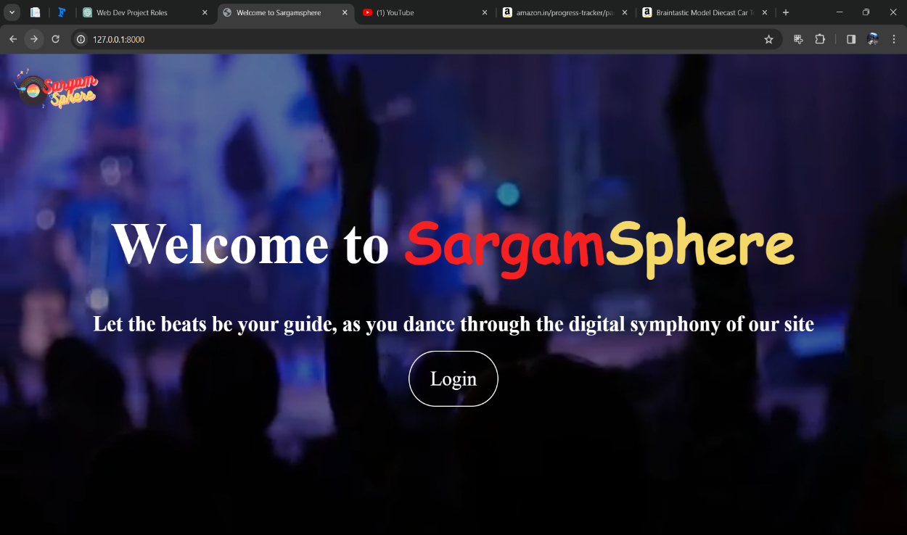
Welcome page

Slide 19
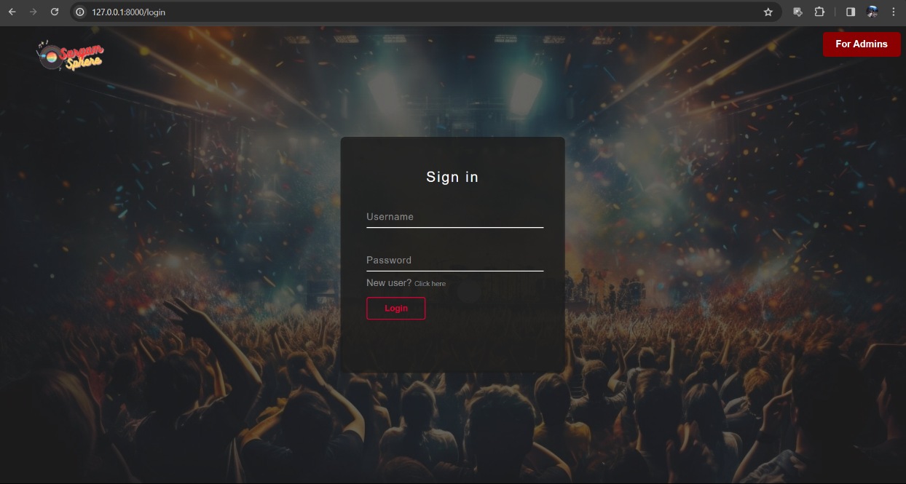
USER LOGIN page

Slide 20
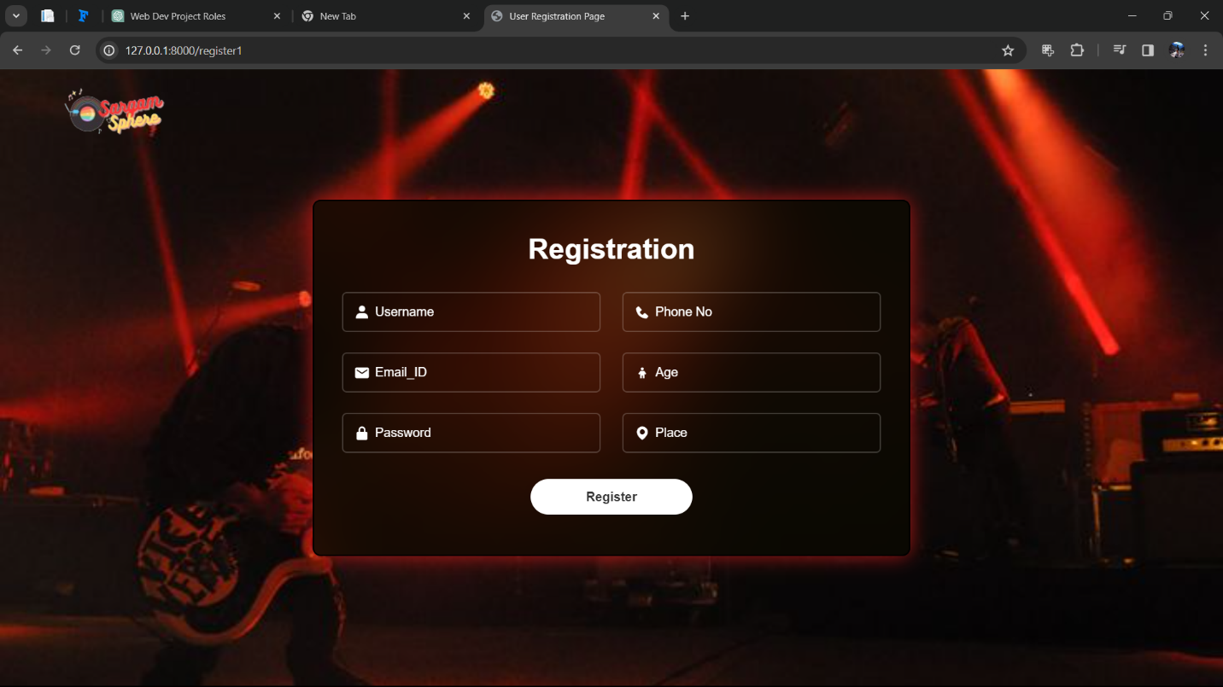
USER REGISTRATION page

Slide 21
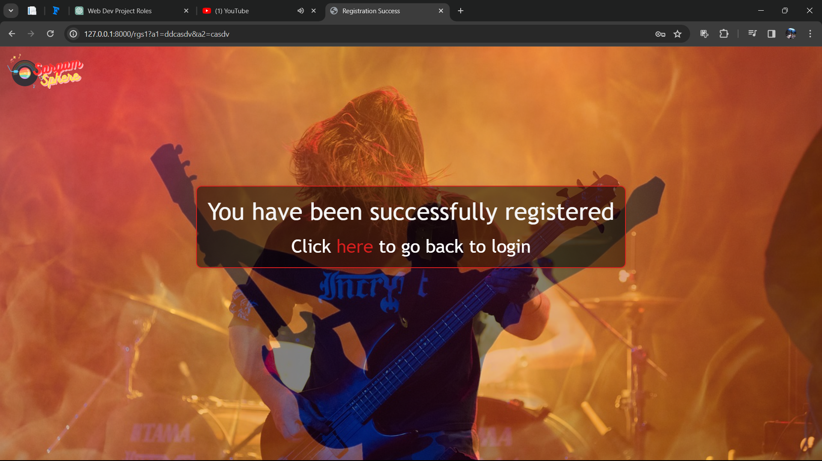
USER SUCCESSFUL REGISTRATION page

Slide 22
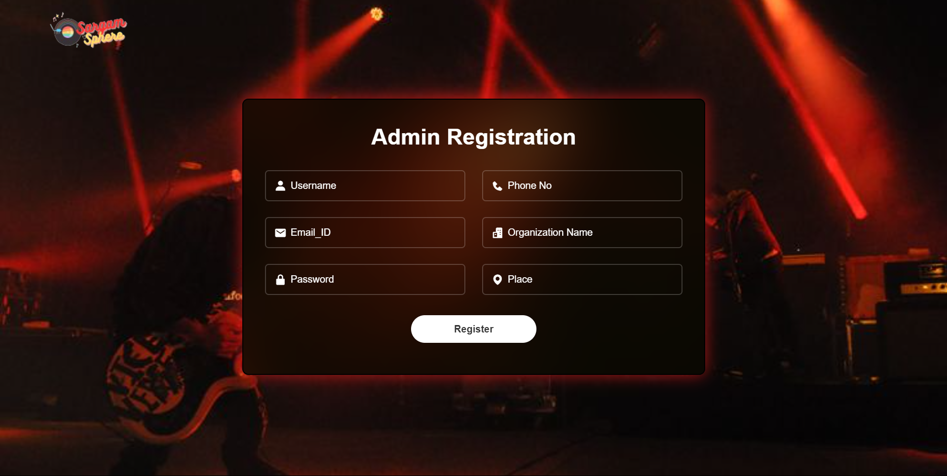
ADMIN REGISTRATION page

Slide 23
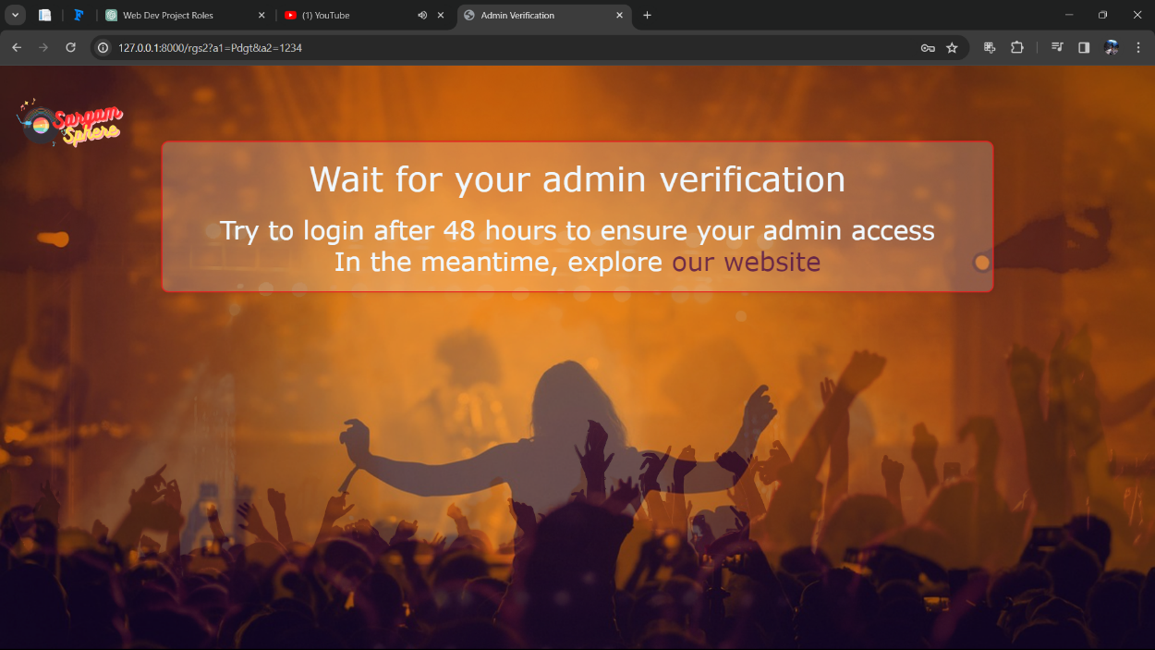
ADMIN VERIFICATIONpage

Slide 24
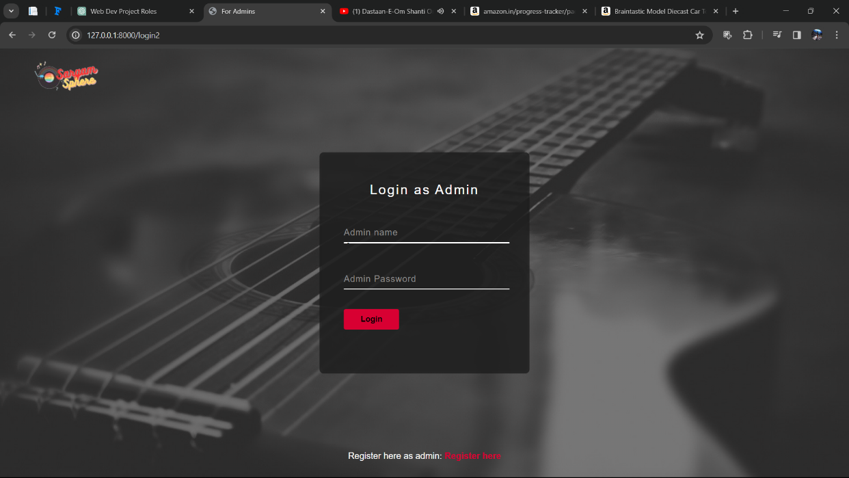
ADMIN LOGIN page

Slide 25
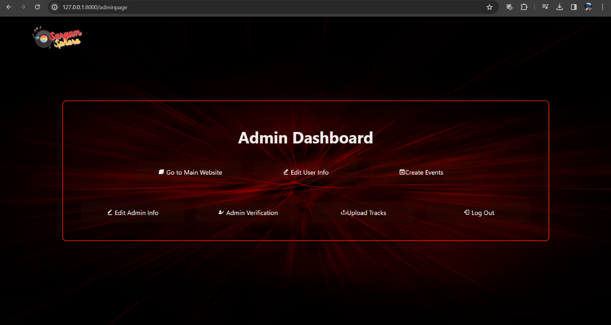
ADMIN DASHBOARD page

Slide 26
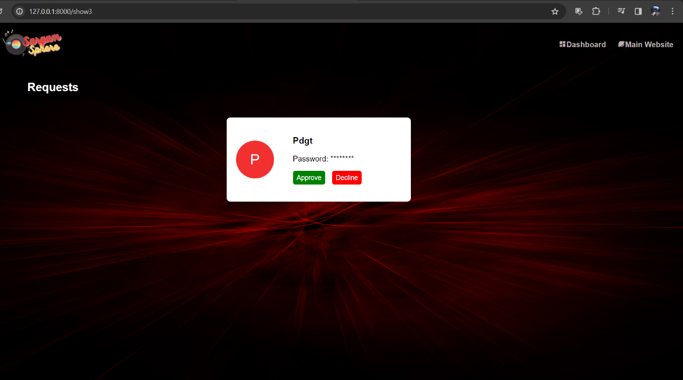
NEW ADMIN REQUEST PERMISSION page

Slide 27
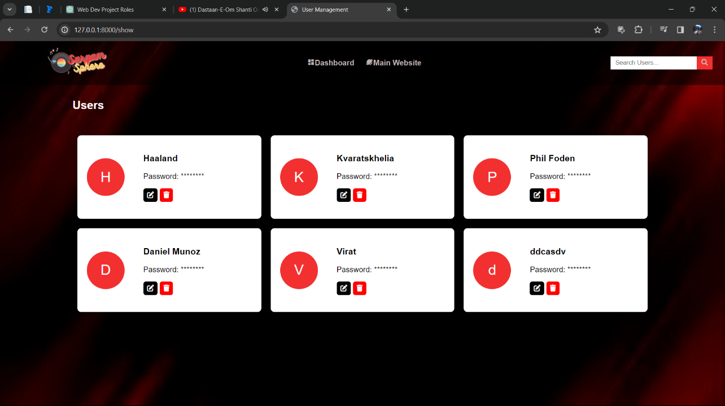
USER INFO page

Slide 28
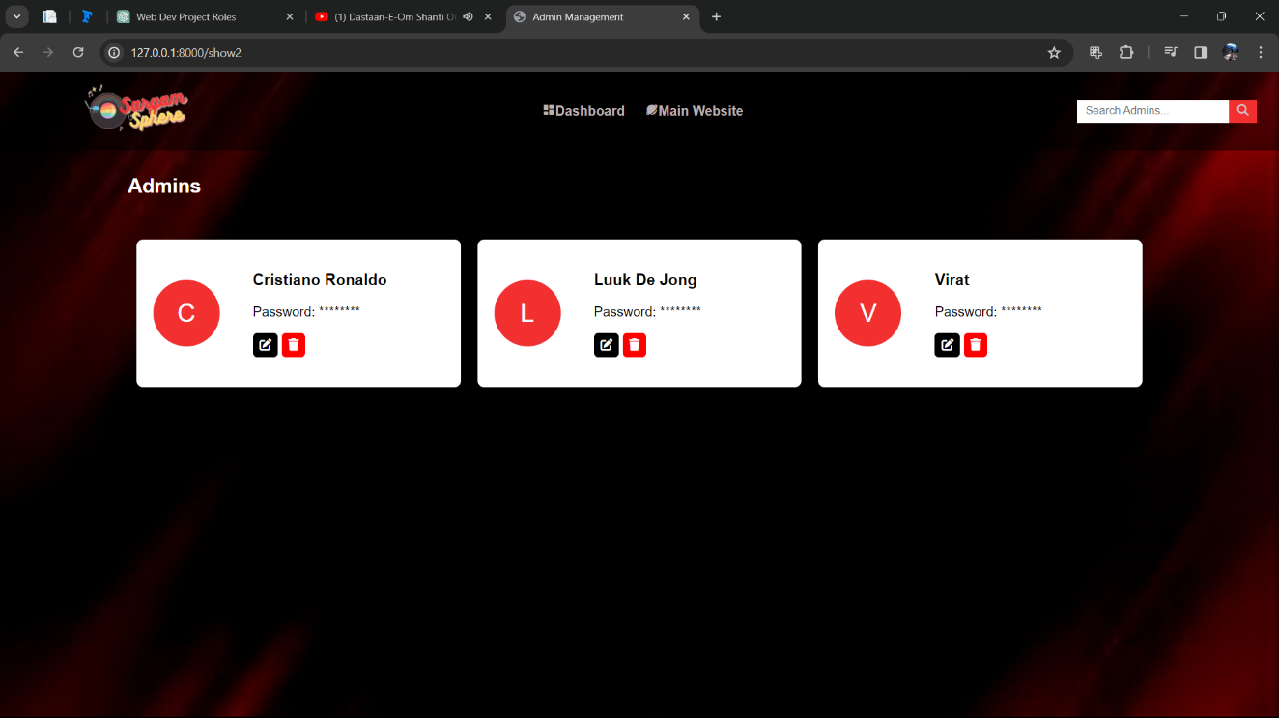
ADMIN INFO page

Slide 29
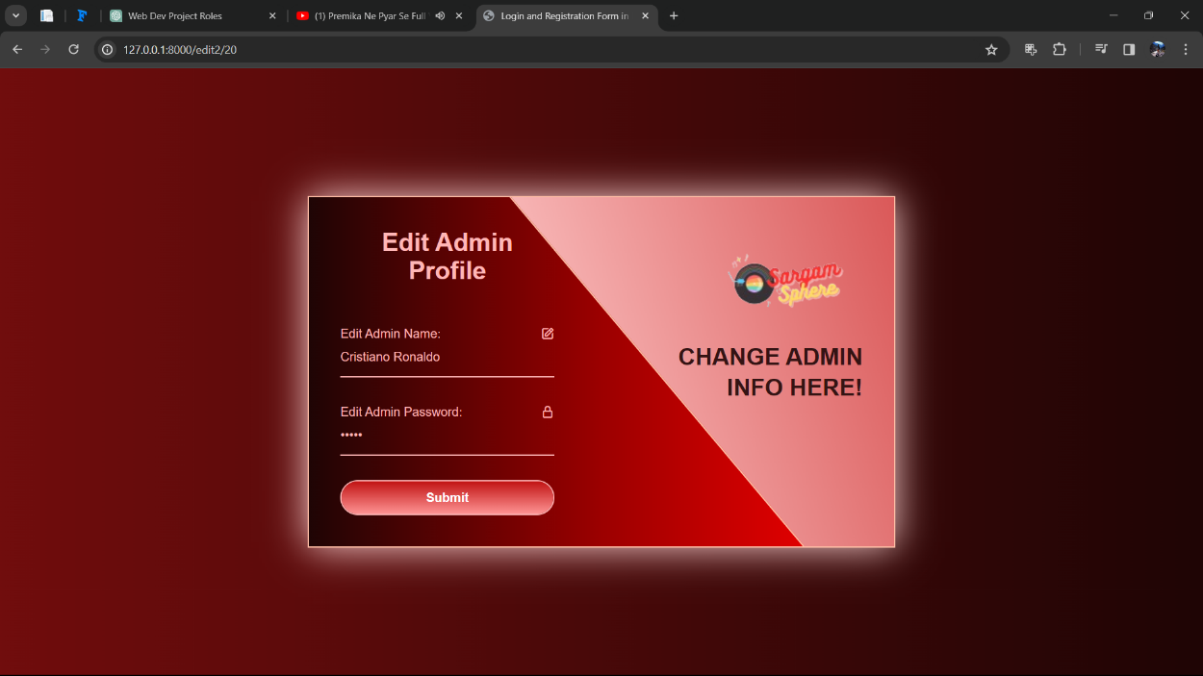
ADMIN INFO EDIT page

Slide 30
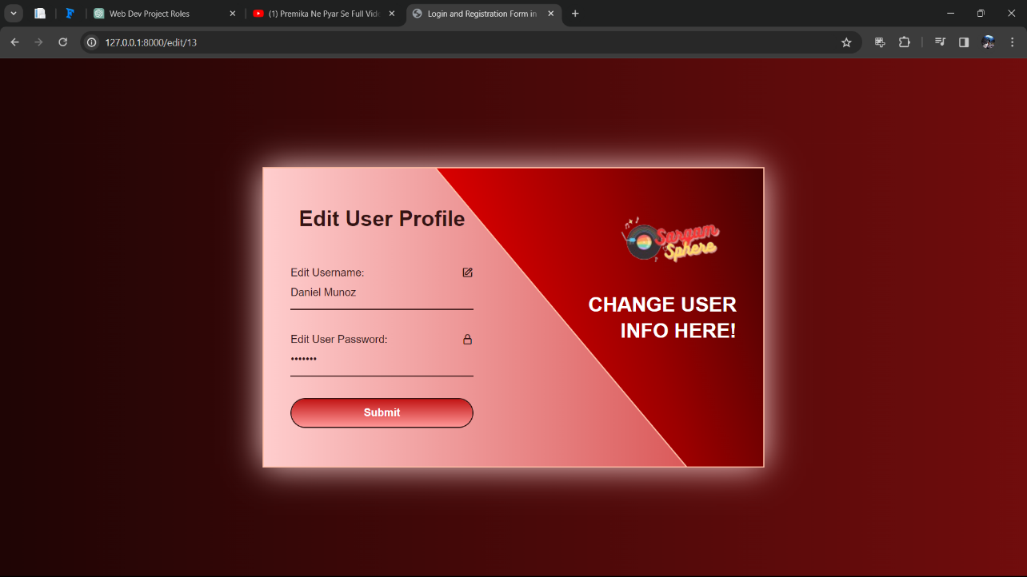
USER INFO EDIT page

Slide 31
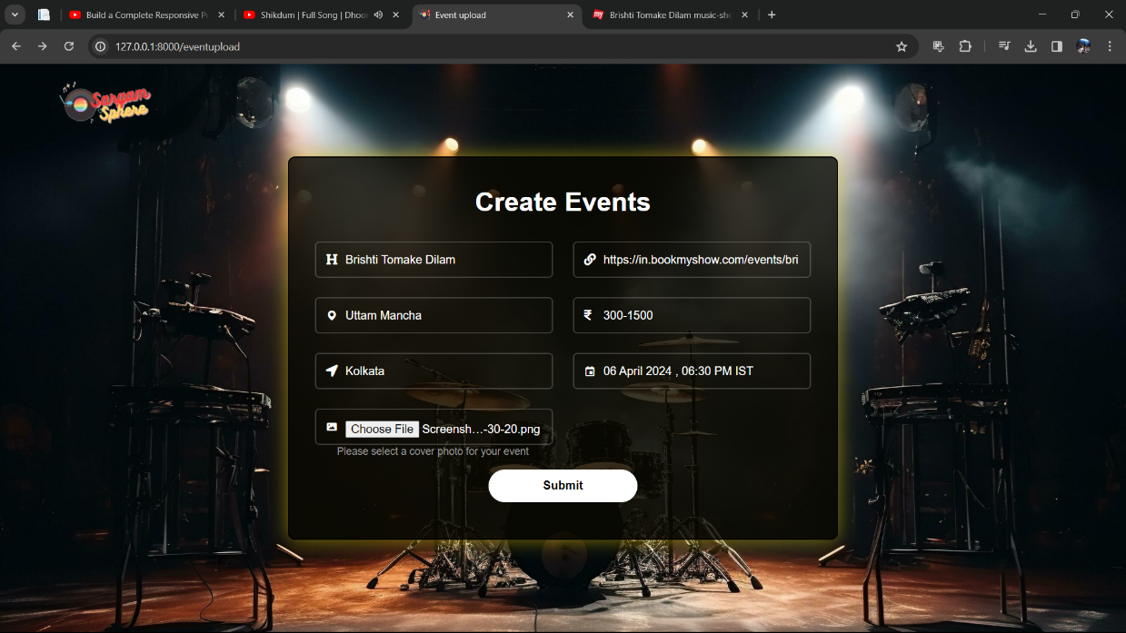
EVENT UPLOAD page

Slide 32
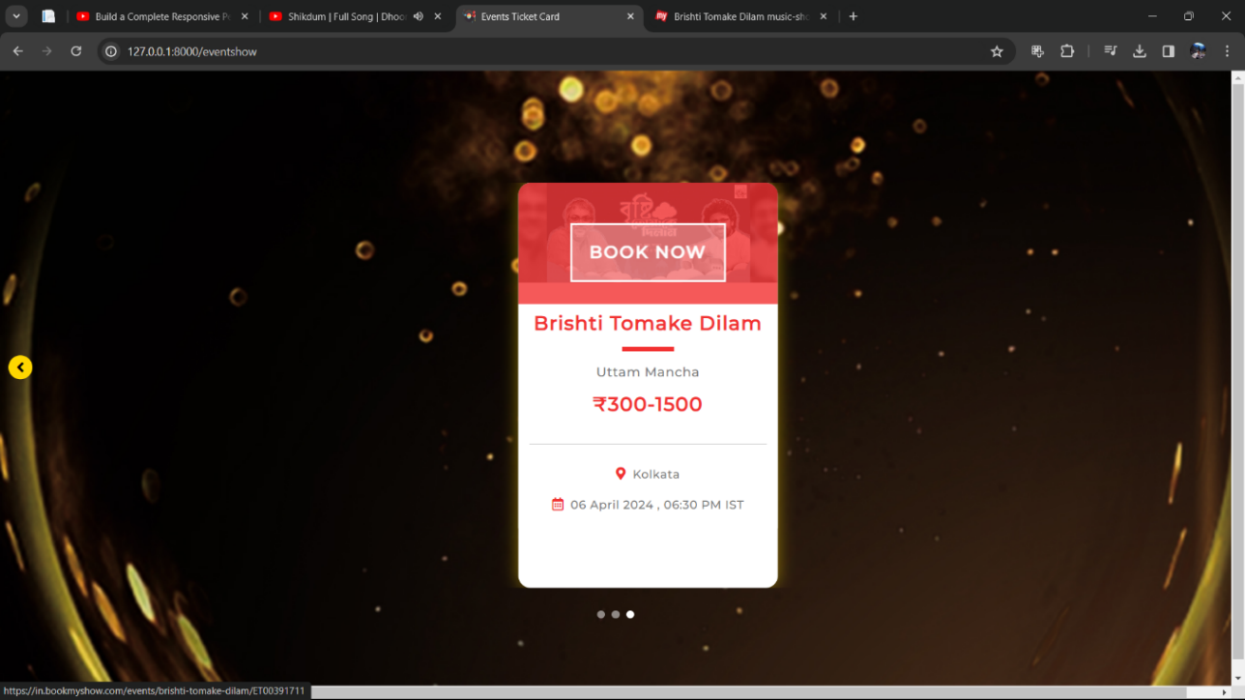
EVENTS page

Slide 33
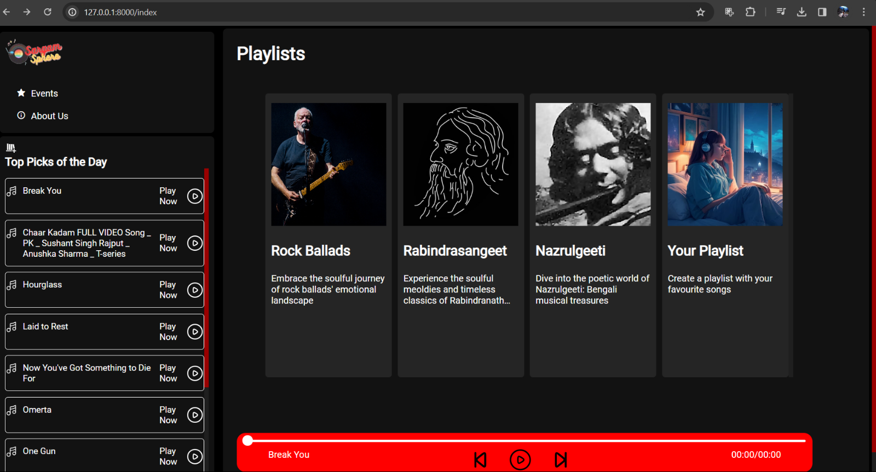
MUSIC STREAMING PLATFORM MAIN webpage

Slide 34
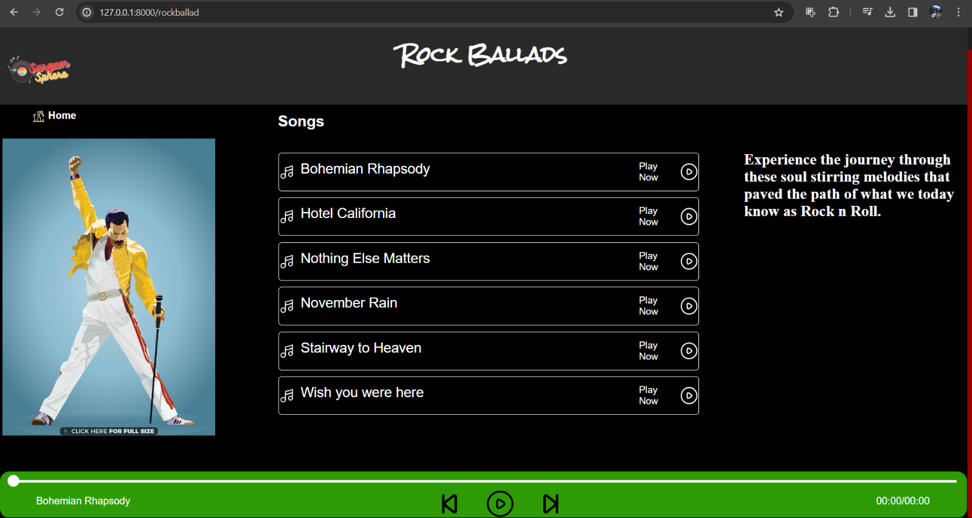
ROCKBALLADS MUSIC STREAMING webpage

Slide 35
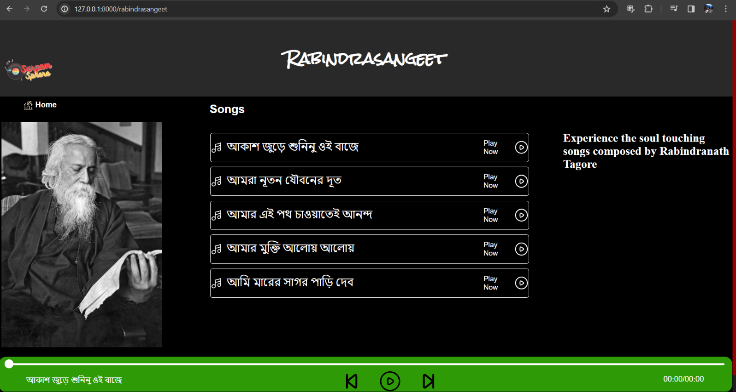
RABINDRASANGEET MUSIC STREAMING webpage

Slide 36
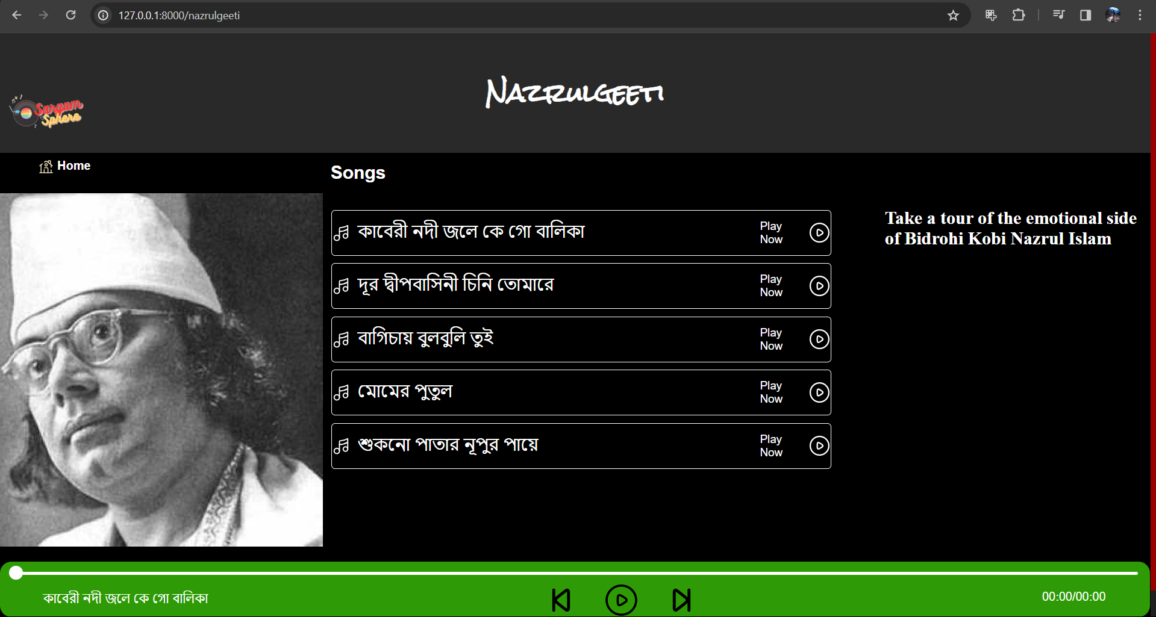
NAZRULGEETI MUSIC STREAMING webpage

Slide 37
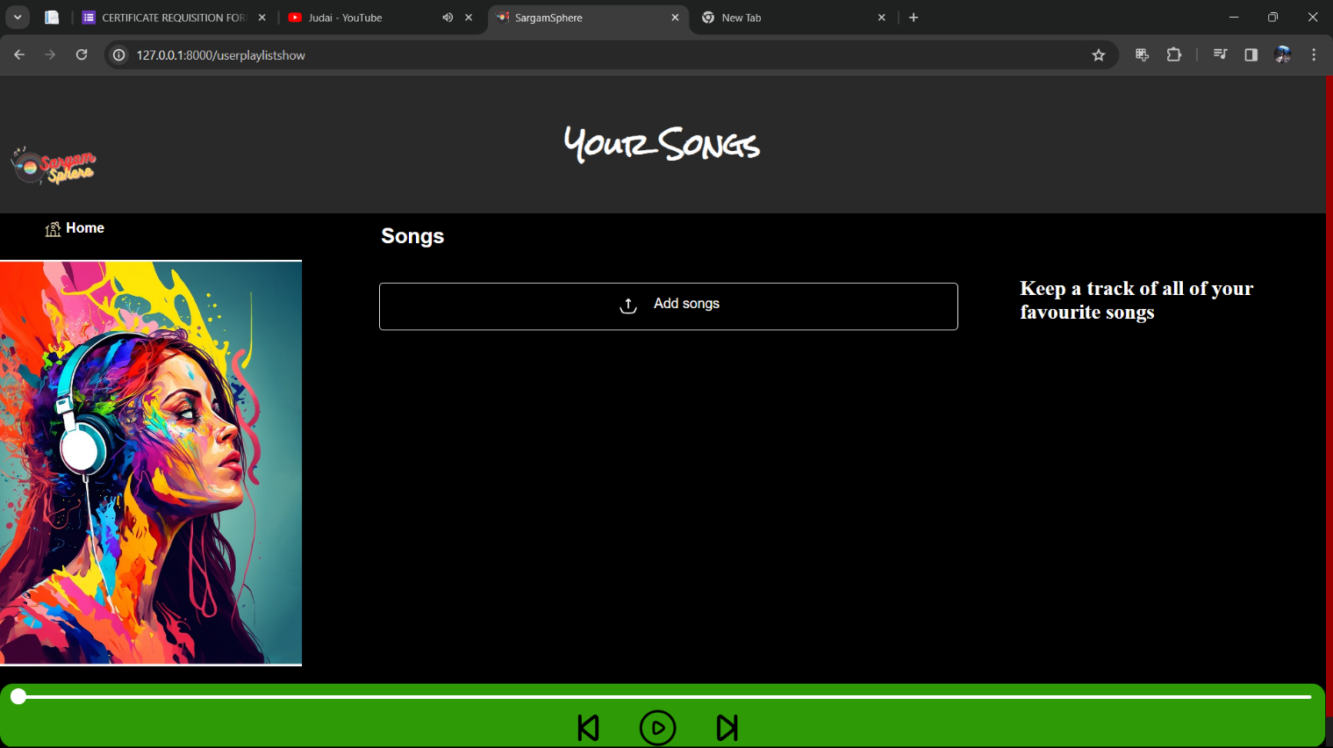
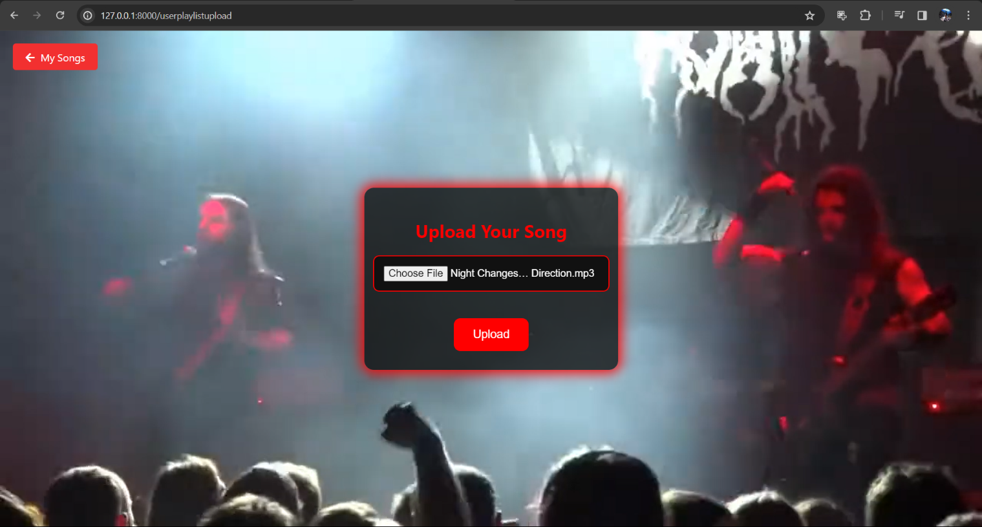
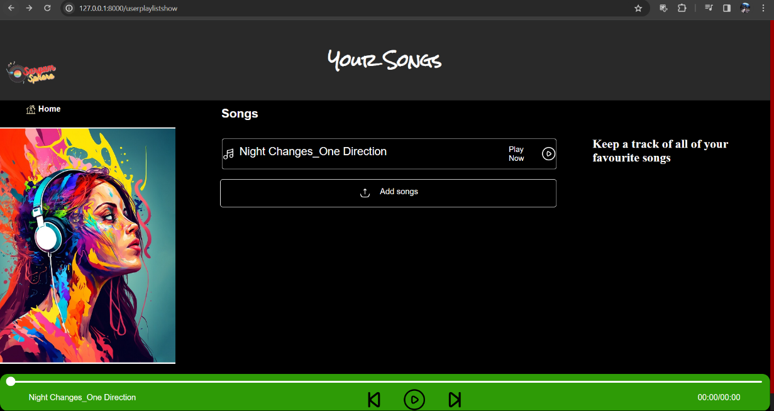
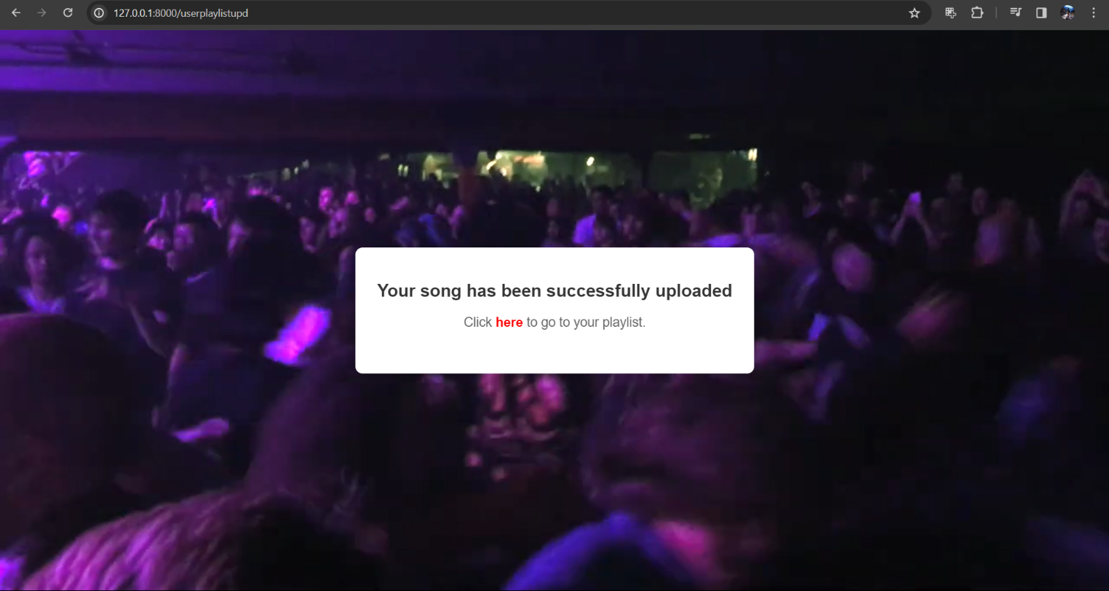
USER PLAYLIST & UPLOAD webpages

Slide 38
FUTURE SCOPE & FURTHER ENHANCEMENTS:
In future we would like to keep working on this project and make new additions to provide users with more advanced features and more detailed information. We have set our sights on the following additions in future: -
Enhanced Personalization Algorithms: Invest in further refining and expanding our personalized recommendation algorithms.
Creation of Music Room: Users can join in a room and can experience various musical taste from all around the community they want to Collab.
Integration of Social Features: Expand the social aspect of the platform by integrating features such as user profiles, social sharing, collaborative playlists, and real-time interaction between users.
Expansion of Content Catalogue: Continuously expand and diversify the platform's content catalogue by partnering with more record labels, independent artists, and music distributors.
Enhanced Audio Quality and Formats: Invest in offering higher-quality audio streaming options, such as lossless audio formats or support for immersive audio technologies like Dolby Atmos and Sony 360 Reality Audio.
Continuous Performance Optimization: Implement ongoing performance optimization efforts to ensure the platform remains fast, reliable, and scalable as user traffic grows
Data Security and Privacy: Strengthen data security measures and privacy protections to safeguard user data and comply with regulatory requirements.

Slide 39
CONCLUSION :
To sum up, our music streaming platform web development project has obtained widespread praise and approbation from users not only within the organization but also outside. Its user interface that is highly intuitive, as well as the screens that are more user-friendly makes it very easy to use and navigate. Through the graphical user interface (GUI), this tool has become a very simple and effective product that highly improves efficiency and reduces effort for users.
With the passage of time, looking back on the project, we see how the way in which users interact with music has changed. Through considering usability and functionality, we not only make a remarkable product but also serve as a foundation for enhanced productive and fun in the organization. We remain committed to constant improvement and enhancement of our platform, which should address the changing requirements of our clients and thus contribute to its recognized role in the digital environment.
BIBLIOGRAPHY :
https://www.w3schools.com
https://www.slideshare.com
https://www.scribd.com
https://www.tutorialspoint.com
https://www.youtube.com

Slide 40

TEAM SARGAMSPHERE
SANGRAM BANERJEE
sangram.banerjee.fit.cseaiml21@teamfuture.in
SUKANYA DAS
sukanya.das.fit.cseaiml21@teamfuture.in
PRIYAN MUKHERJEE
priyan.mukherjee.fit.cseaiml21@teamfuture.in
REETOM CHAKRABORTY
reetom.chakraborty.fit.cseaiml21@teamfuture.in
THANK YOU

